Slide 1

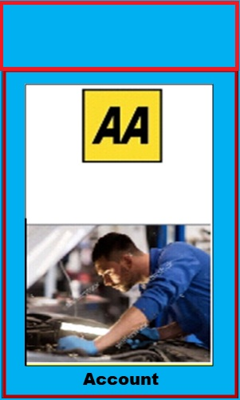
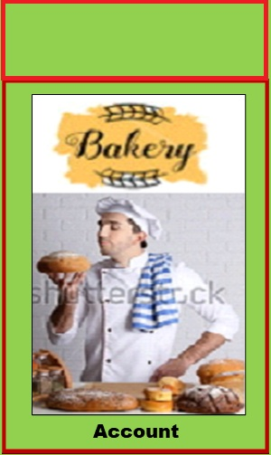

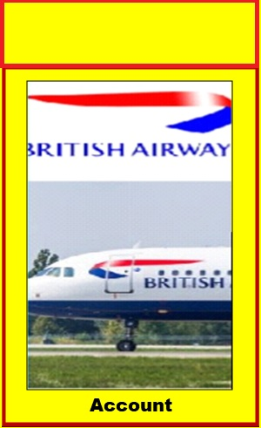
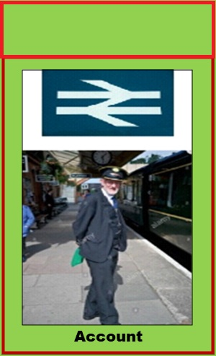



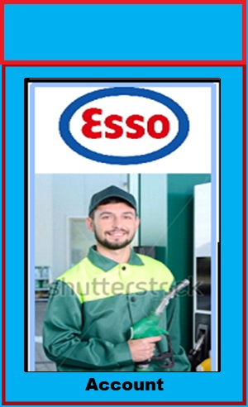
HERE ARE THE 20 DIFFERENT COMPANY BOARD SQUARES

Slide 2
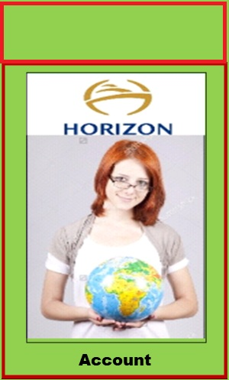
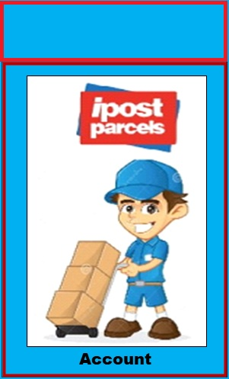
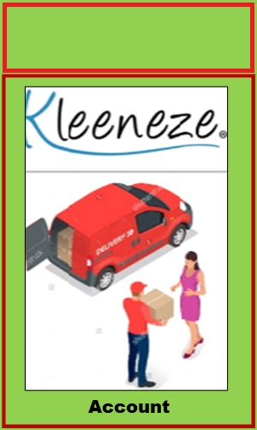

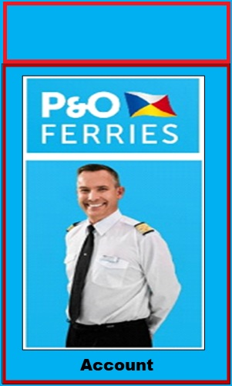
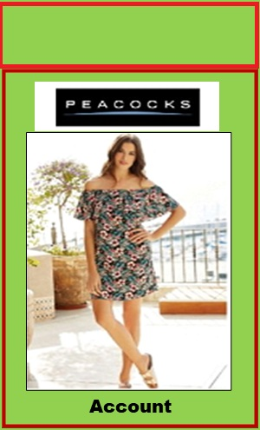
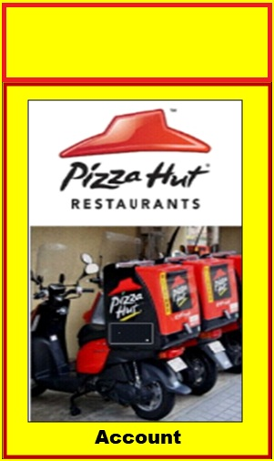




Slide 3
The functions of a player landing on A company square not issued are as follows
Action 1) If landing player lands on a Company Account square that has not been issued. The Highlife Server will present landing player with advert of the company that has sponsored the square, (it will stay on display for 10 seconds with message “click screen to attempt question to gain this account use of a Boffins not allowed). All other players will see sponsor advert whilst landing player is in play. They may use time to check their own Game Account Folder.
Action 1a) If player does not click in the 10 seconds, go ends and passes to next player in turn. All other players will see sponsor advert whilst landing players move is active. They may use time to check their own Game Account Folder.
Action 1b) Player on clicking screen, that colour banded Company Square Dice will role and display value of HECUs for question for player.
Action 1c) Then they will get sponsored question on screen for 20 seconds, which will be read only to them. All other players will be presented with sponsor’s advert, whilst landing players move is active. In this time other players can choose to select to check own Game Account Folder contents.
Action 1d) Landing players screen after 20 seconds will change to display 4 options to answer the question with timer counting down from 20 to zero in seconds. Player must select one answer in the 20 seconds. Or go ends and passes to next player in turn.
Action 2a) If player selects the correct answer in the time. Their Game Folder will be credited with that Company Account, plus 1 Team Worker will be deposited on the Company Square for them, plus they will have credited to their Game Account the value of HECUs reward for question as reward, for each Team Worker they have on that Company Account. Then their go ends and play moves to next player in turn.
Action 2b) If player selects wrong answer, message appears on all player screens player gave wrong answer and their go ends and play moves to next player in turn.

Slide 4
The functions of a player landing on a company square that is issued are as follows
Action 1) Highlife Server will check which player has control of the Company Account.
Action 3) If Highlife Server finds Company Account is issued to landing player. The Highlife Server will present landing player with advert of the company that has sponsored the square, (it will stay on display for 10 seconds with message “click screen to attempt question to gain another Team Work on account, use of a Boffin is allowed, if required select any on screen. If they don’t click on screen in time ,
Action 3a) Automatically that colour banded Company Square Dice will role and display value of 50% of question value to player., they are credited with this amount to there Game Folder. Players go ends and move passes to next player in turn. All other players will see sponsor advert whilst landing player is in play. They may use time to check their own Game Account Folder
Action 3b) If player does click in the 10 seconds. The Highlife Server will present landing player with advert of the company that has sponsored the square, (it will stay on display for 10 seconds with message “click screen to attempt question to gain another Team Worker on this Company Account , use of a Boffins displayed are allowed, if wanted click them now). All other players will see sponsor advert whilst landing player is in play. They may use time to check their own Game Account Folder.
Action 1b) If player selects a Boffin on screen ,on clicking screen, that colour banded Company Square Dice will role and display reduced value of HECUs for using a selected Boffin according to terms of use for help in answering question for player. The Boffin is removed from player after use.
Action 1c) Then they will get sponsored question on screen for 20 seconds, which will be read only to them. All other players will be presented with sponsor’s advert, whilst Landing players move is active. In this time other players can choose to select to check own Game Account Folder contents.
Action 6) Player is not allowed to use Boffins to answer Consultation Questions.
if Game Server finds they have, then displayed on screen at same time player will see displayed any Boffins that they have in their Game Folder that they could used to help answer the question. With message you have 10 seconds to click one to help you. Using boffins will reduce value of reward to question. Clicking on Boffin will activate relative level of help. If player clicks a Boffin it will be taken from the screen , then the player then has another 10 seconds to answer question. Then (Action 4) Comes into play. If player selects wrong answer (Action 4a) Comes into play.

Slide 5
The functions of a player landing on a company square that is issued are as follows continued.
Action 1d) After player clicks a Boffin, Landing players screen after 20 seconds will change to display 4 options to answer the question with timer counting down from 20 to zero in seconds. Player must select one answer in the 20 seconds. Or go ends and passes to next player in turn.
Action 2a) If player selects the correct answer in the time. Their Game Folder will be credited with the reduced reward value for each Team Worker on the Company Account plus 1 Team Worker will be deposited on the Company Square for them. Then their go ends and play moves to next player in turn.
Action 2b) If player selects the wrong answer , message will appear on all players screens” players knowledge let him down”. Move goes to next player in turn.

Slide 6
If landing player lands on Company Account square under control of another player
Action 1) Highlife Server will check which player has control of the Company Account
Action 1) Server will send that player this message automatically “Landing player (Name ----) wants to consult with you”. Click screen to get question, no Boffins allowed to help.
Action 2a) Then they will get sponsored question on screen for 20 seconds, which will be read only to them. All other players will be presented with sponsor’s advert, whilst Landing players move is active. In this time other players can choose to select to check own Game Account Folder contents.
Action 2b) On clicking screen that colour banded Company Square Dice will role and display value of question for player of basic 10% value as reward FEE for selecting correct answer to question. Action 2 c) Reward that would have been displayed as reward in (Action 2) is reduced too 10% of basic value only. In this time other players can choose to select to check own Game Account Folder contents.
Action 2c If player selects correct answer in allocated time, their Game Account is credited with value of HECUs and move ends and passes to next player in turn.
Action 4a) If player selects wrong answer, message appears “Bad Consultation advise” this appears on all players screens, as warning of poor knowledge given. Landing player is compensated with 3 x Consultation FEE value of HECUs which is credited to there Game Account for the poor help given with question answer and their go ends. Play moves to next player in turn.

